Slide 1
Workers Compensation & Medical Treatment: What We’ve Got Here is Failure to Communicate!

Slide 2
Presenters
Barbara Seymoure, MPH
Workers’ Compensation
Manager, Medical Provider Networks
Tom Barnes
Vice President, GBCARE
Workers’ Compensation
Managed Care Networks & Legislation

Slide 3
What we got here is …

Slide 4
Introduction
Whether an CA MPN is used or not, all California Employers are still required to adhere to California Regulations pertaining to the DWC-7 posting, Time of Hire Pamphlets, and Predesignation Forms.
Frequently, employers have difficulty understanding how & when these different state regulations interact with a MPN that has been implemented; what needs to be given and explained to employees and when; and what needs to be posted at the workplace.
Today’s presentation will provide you with information on these overlapping regulations, and to improve & assist with communications for injured employees.
For Gallagher Bassett Services (GB), we service over 1,400 clients who have implemented a CA MPN.

Slide 5
presentation disclaimer
The content of this presentation is provided for informational purposes only, from a general insurance/risk management perspective, with the understanding that GB is not rendering legal, accounting or other professional advice on specific matters.
GB recommends that you seek the advice of legal counsel in order to become fully apprised of the legal implications related to the information provided as such implications are highly dependent on the unique facts and circumstances applicable to an individual situation.

Slide 6
discussion topics
Time of Hire Pamphlet “Facts About Workers’ Compensation”
The time of hire pamphlet is covered under LC 3551 and CCR 9880.
DWC-7 Notice to Employees Poster Injuries Caused by Work
The required posted notices are covered under LC 3550 and CCR 9881.
Predesignation of Personal Physicians and Reporting Duties of the Primary Treating Physician Regulations
Title 8, California Code of Regulations, Sections 9780, 9780.1, 9783, 9783.1, and 9785.
CA MPN Regulations – Employee Notifications
Title 8 California Code of Regulations, Chapter 4.5. Division of Workers' Compensation, Subchapter 1. Administrative Director -- Administrative Rules, Article 3.5. Medical Provider Networks: Sections 9767.1 - 9767.19.

Slide 7
Time of Hire Pamphlet “Facts About Workers’ Compensation”
California Labor Code – 3551
(a) Every employer subject to the compensation provisions of this code, except employers of employees defined in subdivision (d) of Section 3351, shall give every new employee, either at the time the employee is hired or by the end of the first pay period, written notice of the information contained in Section 3550. The content of the notice required by this section shall be prescribed by the administrative director after consultation with the Commission on Health and Safety and Workers' Compensation.
§9880. Written Notice to New Employees.
a) Every employer shall provide to every new employee, either at the time of hire or by the end of the first pay period, the Written Notice to New Employees concerning the rights, benefits and obligations under worker's compensation law. The content of the notice must be approved by the Administrative Director.
(b) The notice shall be easily understandable. It shall be available in both English and Spanish where there are Spanish-speaking employees.

Slide 8
Time of Hire Pamphlet “Facts About Workers’ Compensation”
§9880. Written Notice to New Employees.
(c) The notice provided shall be in writing, in non-technical terms and shall include the following information:
(1) The name of the current compensation insurance carrier of the employer at the time of distribution, or when such is the fact, that the employer is self-insured, and who is responsible for claims adjustment;
(2) How to get emergency medical treatment, if needed;
(3) The kind of events, injuries and illnesses covered by workers' compensation;
(4) The injured employee's right to receive medical care;
(5) How to obtain appropriate medical care for a job injury;
(6) The role and function of the primary treating physician;
(7) The rights of the employee to select and change the treating physician pursuant to the provisions of Labor Code Sections 4600 to 4601, including the right to predesignate a personal physician or medical group;

Slide 9
Time of Hire Pamphlet “Facts About Workers’ Compensation”
§9880. Written Notice to New Employees.
(c) The notice provided shall be in writing, in non-technical terms and shall include the following information:
(8) A form that the employee may use as an optional method for notifying the employer of the name of the employee's “personal physician,” as defined by Labor Code Section 4600, or “personal chiropractor,” as defined by Labor Code Section 4601;
(9) The rights of the employee to receive temporary disability indemnity, permanent disability indemnity, supplemental job displacement benefits, and death benefits, as appropriate;
(10) To whom the injuries should be reported;
(11) The existence of time limits for the employer to be notified of an occupational injury;
(12) The protections against discrimination provided pursuant to Section 132a

Slide 10
Time of Hire Pamphlet “Facts About Workers’ Compensation”
§9880. Written Notice to New Employees.
(13) The location and telephone number of the nearest information and assistance officer, including an explanation of services available; and
(14) A description about Medical Provider Networks ( “MPN”) which includes that the employer may be using a MPN, what a MPN is, the predesignation exemption from the MPN, when an employee must begin to use a physician from the MPN, and how to request information about using a MPN.

Slide 11
Time of Hire Pamphlet “Facts About Workers’ Compensation”
The Written Notice to New Employees is not a formal notice of the CA MPN. Please refer to the CA MPN Regulations on Employee Notifications.
The Written Notice regulations do not contain an acknowledgement of receipt by the employee.
The Written Notice does provide information on Predesignation.
The CA DIR Internet Site does have an English version that also has the full predesignation information and forms. https://www.dir.ca.gov/dwc/DWCPamphlets/TimeOfHirePamphlet.pdf
You may also contact your claims handler or insurance carrier for the Written Notice, or conduct research on the Internet to purchase it.
If your organization elects to create its own Written Notice, then the California Time of Hire Workers' Compensation Pamphlet must be approved by the Division of Workers' Compensation.

Slide 12
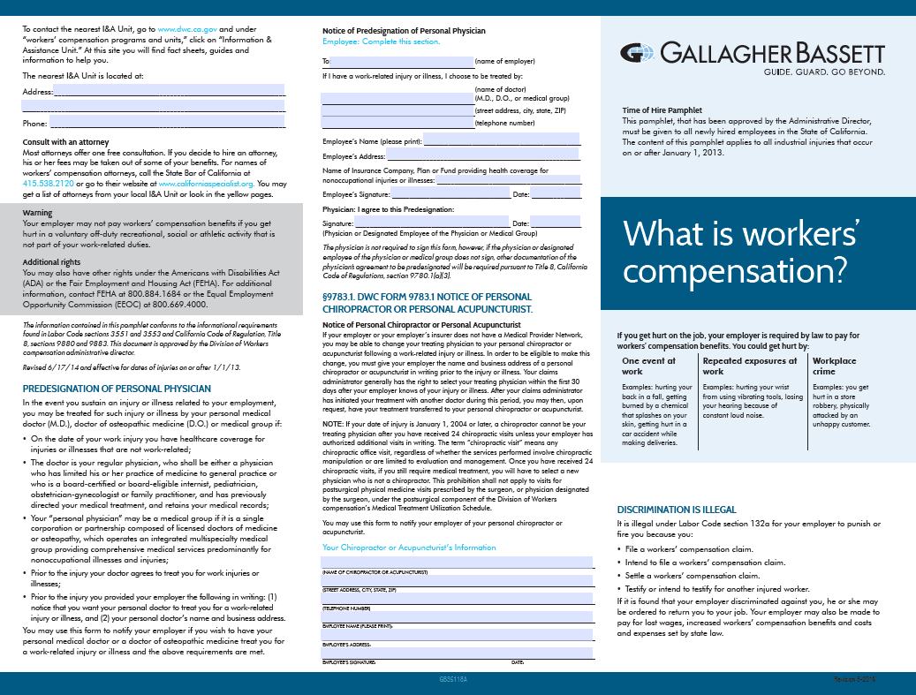
Time of Hire Pamphlet – Sample

Slide 13
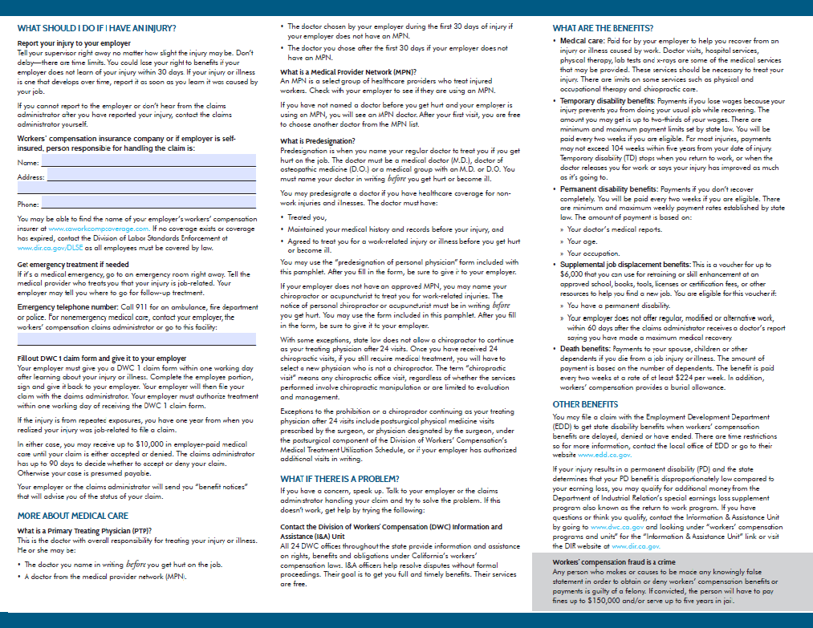
Time of Hire Pamphlet – Sample

Slide 14
DWC-7 Notice to Employees Poster Injuries Caused by Work
California Labor Code – 3550
(a) Every employer subject to the compensation provisions of this division shall post and keep posted in a conspicuous location frequented by employees, and where the notice may be easily read by employees during the hours of the workday, a notice that states the name of the current compensation insurance carrier of the employer, or when such is the fact, that the employer is self-insured, and who is responsible for claims adjustment.
(b) Failure to keep any notice required by this section conspicuously posted shall constitute a misdemeanor, and shall be prima facie evidence of noninsurance.
(d) The form and content of the notice required by this section shall be prescribed by the administrative director, after consultation with the Commission on Health and Safety and Workers‘ Compensation, and shall advise employees that all injuries should be reported to their employer. The notice shall be easily understandable. It shall be posted in both English and Spanish where there are Spanish-speaking employees.

Slide 15
DWC-7 Notice to Employees Poster Injuries Caused by Work
California Labor Code – 3550
(e) Failure of an employer to provide the notice required by this section shall automatically permit the employee to be treated by his or her personal physician with respect to an injury occurring during that failure.
(f) The form and content of the notice required to be posted by this section shall be made available to self-insured employers and insurers by the administrative director. Insurers shall provide this notice to each of their policyholders, with advice concerning the requirements of this section and the penalties for a failure to post this notice.

Slide 16
DWC-7 Notice to Employees Poster Injuries Caused by Work
§9881. Posting of Notice to Employees.
a) Every employer shall post and keep posted in a conspicuous location frequented by employees during the hours of the workday a Notice to Employees.
(b) The Notice to Employees poster shall be easily understandable. It shall be posted in both English and Spanish where there are Spanish-speaking employees.
(c) The Notice to Employees poster shall include the following information:
(1) The name of the current compensation insurance carrier of the employer, or when such is the fact, that the employer is self-insured, and who is responsible for claims adjustment.
(2) How to get emergency medical treatment, if needed.
(3) Emergency telephone number(s), for hospital, ambulance, police and firefighting services.
(4) The kinds of events, injuries and illnesses covered by workers' compensation.

Slide 17
DWC-7 Notice to Employees Poster Injuries Caused by Work
§9881. Posting of Notice to Employees.
(c) The Notice to Employees poster shall include the following information:
(5) Advice that the employer may not be responsible for compensation because of an injury due to the employee's voluntary participation in any off-duty recreational, social, or athletic activity that is not a part of the employee's work-related duties.
(6) The injured employee's right to receive medical care.
(7) The rights of the employee to select and change the treating physician pursuant to the provisions of Labor Code Section 4600, including the right to predesignate a personal physician or medical group.
(8) The rights of the employee to receive temporary disability indemnity, permanent disability indemnity, supplemental job displacement benefits, and death benefits, as appropriate.

Slide 18
DWC-7 Notice to Employees Poster Injuries Caused by Work
§9881. Posting of Notice to Employees.
(c) The Notice to Employees poster shall include the following information:
(9) To whom the injuries should be reported.
(10) The existence of time limits for the employer to be notified of an occupational injury.
(11) The protections against discrimination provided pursuant to Labor Code Section 132a.
(12) The location and telephone number of the nearest information and assistance officer.

Slide 19
DWC-7 Notice to Employees Poster Injuries Caused by Work
§9881. Posting of Notice to Employees.
(c) The Notice to Employees poster shall include the following information:
(13) A description about Medical Provider Networks ( “MPN”) which includes what a MPN is, the predesignation exemption from the MPN, when an employee must begin to use a physician from the MPN, and how to request information about using a MPN. The MPN Contact telephone number, address and, if available, the MPN website address/URL shall be included. The effective date of MPN coverage for the MPN being used by the employer to cover current injuries shall also be stated if the employer is using an MPN.
(d) The employer may post the Administrative Director's approved Notice to Employee Poster provided in Section 9881.1. If the employer chooses not to use the Notice to Employee Poster provided in Section 9881.1, the employer may use a poster which meets the posting requirements of Labor Code Section 3550, includes the information required by this regulation, and has been approved by the Administrative Director.

Slide 20
DWC-7 Notice to Employees Poster Injuries Caused by Work
To download the CA DWC-7, please access this URL:
https://www.dir.ca.gov/dwc/NoticePoster.pdf
All employers are required to post the CA DWC-7. If there is no MPN, then that section is left blank.

Slide 21
DWC-7 Notice to Employees Poster – key fields

Slide 22
Predesignation of Personal Physicians and Reporting Duties of the Primary Treating Physician Regulations
Previous slides and documents covered within this presentation lists the various ways that you may inform your employees about predesignation of a personal physician. If an employee has properly predesignated their personal physician prior to an injury, the employee may treat with their own personal physician from the moment of injury forward without consideration of the employer’s right to control medical care for the first 30 days or with an employer’s MPN.
§9780.1. Employee's Predesignation of Personal Physician
https://www.dir.ca.gov/t8/9780_1.html
§9783. DWC Form 9783 Predesignation of Personal Physician
https://www.dir.ca.gov/t8/9783.html
To download the DWC Form 9783, please access this URL:
https://www.dir.ca.gov/dwc/FORMS/DWCForm_9783.pdf

Slide 23
CA MPN Regulations – Employee Notifications
Labor Code 4600 – Direction of Care: Non-MPN
(c) Unless the employer or the employer’s insurer has established or contracted with a medical provider network as provided for in Section 4616, after 30 days from the date the injury is reported, the employee may be treated by a physician of his or her own choice or at a facility of his or her own choice within a reasonable geographic area. A chiropractor shall not be a treating physician after the employee has received the maximum number of chiropractic visits allowed by subdivision (c) of Section 4604.5.
(d) (1) If an employee has notified his or her employer in writing prior to the date of injury that he or she has a personal physician, the employee shall have the right to be treated by that physician from the date of injury if the employee has health care coverage for nonoccupational injuries or illnesses on the date of injury in a plan, policy, or fund as described in subdivisions (b), (c), and (d) of Section 4616.7.

Slide 24
CA MPN Regulations – Employee Notifications
§9767.6. Treatment and Change of Physicians Within MPN.
(a) When the injured covered employee notifies the employer or insured employer of the injury or files a claim for workers' compensation with the employer or insured employer, the employer or insurer or entity that provides physician network services shall arrange an initial medical evaluation with a MPN physician in compliance with the access standards set forth in section 9767.5.
(d) The insurer or employer shall notify the employee of his or her right to be treated by a physician of his or her choice within the MPN after the first visit with the MPN physician and the method by which the list of participating providers may be accessed by the employee.

Slide 25
CA MPN Regulations – Employee Notifications
§9767.12. Employee Notification
When an injury is reported or an employer has knowledge of an injury that is subject to an MPN or when an employee with an existing injury is required to transfer treatment to an MPN, a complete written MPN employee notification with the information specified in paragraph (2) of this subdivision, shall be provided to the covered employee by the employer or the insurer for the employer. This MPN notification shall be provided to employees in English and also in Spanish if the employee primarily speaks Spanish.
Note: The MPN regulations are silent for calendar or business days to notify an employee about a MPN, and there is no mention of an MPN Employee Acknowledgement Letter.

Slide 26
CA MPN Regulations – Employee Notifications
§9767.1. Medical Provider Networks –Definitions
In addition to the Employer’s right to initially direct medical treatment within the MPN, the MPN Contact Definition was changed and a new Medical Access Assistant position was added to 2014 Regulations.
(16) “Medical Provider Network Medical Access Assistant” means an individual in the United States provided by the Medical Provider Network to help injured workers with finding available Medical Provider Network physicians of the injured workers’ choice and with scheduling provider appointments.

Slide 27
CA MPN Regulations – Employee Notifications
§9767.1. Medical Provider Networks –Definitions
In addition to the Employer’s right to initially direct medical treatment within the MPN, the MPN Contact Definition was changed and a new Medical Access Assistant position was added to 2014 Regulations.
(20) “MPN Contact” means an individual(s) designated by the MPN Applicant in the employee notification who is responsible for responding to complaints, for answering employees' questions about the Medical Provider Network and for assisting the employee in arranging for an MPN independent medical review pursuant to Labor Code section 4616.4.
Additional Note: The MPN Contact can assist with the following:
For provider look up and referrals, and to determine if a provider is in the MPN
To request electronic copies or CD of MPN directories of regional listings
General questions on providers’ status in the MPN
For help to find a provider or a specific provider specialty in a particular service area

Slide 28
CA MPN Regulations – Employee Notifications
The MPN Contact and MPN Medical Access Assistant Are Not Responsible for the following:
Clerical assistance to claims adjusters
Providing legal advice
Receiving & approving treatment authorization requests
Approving and paying medical bills
Interpreting medical reports
Scheduling medical treatment in other state jurisdictions
Approving additions or removals from the MPN
Updating group provider rosters
Provide assistance on other MPNs

Slide 29
The Titanic Effect when Navigating the 2014 CA MPN Regulations
The MPN Employee Notification Document is the key to navigate around the Iceberg
MPN Employee Notification
MPN Complaints
DWC MPN Random Reviews
The anchor is proper use of the MPN Employee Notification Document
Administrative Penalty Schedule; Hearing
Petition to Suspend or Revoke a Medical Provider Network
Workers’ Compensation Appeals Board (WCAB) Rules of Practice & Procedure
Potential for Department of Insurance Investigations

Slide 30
CA MPN Regulations – Employee Notifications
§9767.12. Employee Notification – Important Sections
MPN Name and Identification Number
How do I find out which doctors are in my MPN?
Internet Site to Locate Providers
Toll-Free Number to the MPN Contact and Medical Access Assistant
Locating a pharmacy
What happens if I get injured at work?
How do I choose a provider?
Can I change providers?

Slide 31
CA MPN Regulations – Employee Notifications
§9767.12. Employee Notification – Important Sections
What standards does the MPN have to meet?
What if there are no MPN providers where I am located?
What if I need a specialist that is not available in the MPN?
What if I disagree with my doctor about medical treatment?
MPN Independent Medical Review (IMR) Process

Slide 32
CA MPN Regulations – Employee Notifications
§9767.12. Employee Notification – Important Sections
What if I am already being treated for a work-related injury before the MPN begins?
Transfer of Care Policy
Treatment exceptions under the Transfer of Care Policy
What if I am being treated by a MPN doctor who decides to leave the MPN?
Continuity of Care Policy
Treatment exceptions under the Continuity of Care Policy
What if I have questions or need help?
CA DWC availability for questions on Independent Medical Reviews

Slide 33
End of Medical Provider Network (MPN) Coverage Notice for Changing MPNs
Section 9767.12. Employee Notification:
(b) When MPN coverage will end, the employer or the insurer for the employer shall ensure each injured covered employee who is treating under its MPN is given written notice of the date the employee will no longer be able to use its MPN. The notice required by this section shall be provided in English and also in Spanish if the employee speaks Spanish.
(1) The employer or the insurer for the employer shall ensure that every affected injured covered employee using its MPN is provided the following information prior to the date its MPN coverage ends:
A) The effective date the employee can no longer use the MPN. The unique MPN Identification number shall be stated in the notice.
(B) Whether the MPN will still be used for injuries arising before the date MPN coverage ends.
(C) The address(es), telephone number(s), and email address(es) of the MPN Contact and MPN Medical Access Assistants who can address MPN questions, and an MPN website.
(D) For periods when an employee is not covered by a MPN, an employee may choose a physician 30 days after the date the employee notified the employer of his or her injury.

Slide 34
What are we going to say to them?

Slide 35
Open Discussion and Additional Questions
Thank you for participating in today’s presentation.

