Slide 1
Complex Regional Pain Syndrome
Steven D. Feinberg, MD, MS, MPH
Board Certified, Physical Medicine & Rehabilitation Board Certified, Pain Medicine Adjunct Clinical Professor, Stanford School of Medicine
Feinberg Medical Group stevenf@stanford.edu
Annu Navani, MD
Board Certified, Anesthesiology and Pain Medicine Chief Medical Officer, IPM Medical Group Adjunct Clinical Associate Professor, Stanford University School of Medicine anavani@ipmdoctors.com
William M. Zachry
Board Member State Compensation Insurance Fund wzachry@gmail.com

Slide 2
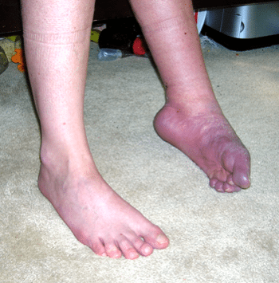
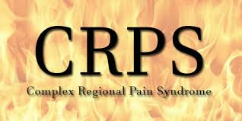
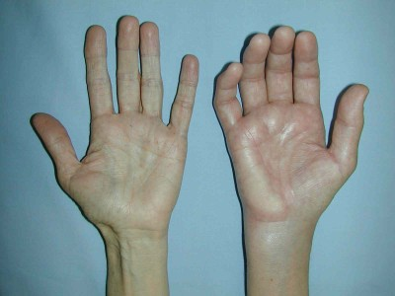
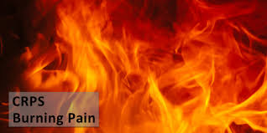
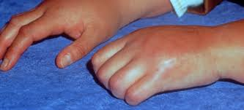
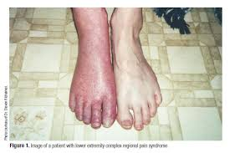
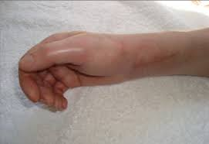
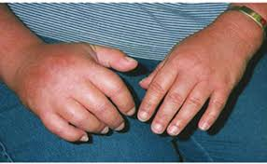
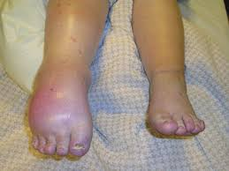

Slide 3
CRPS Presentation Outline
What is Complex Regional Pain Syndrome?
Why is the diagnosis controversial?
What is the cause of CRPS?
How does CRPS present & how is it diagnosed?
How is CRPS medically treated?
What is the impact of CRPS on disability and claim costs?

Slide 4
What is Complex Regional Pain Syndrome?
The term CRPS is meant as a descriptor
no assumptions about underlying physical cause
CRPS is a syndrome
Subjective symptoms and physical signs match criteria
A neuropathic (nervous system) pain condition
CRPS uncommon (incidence 5.5/100,000; prevalence 20-25/100,000)
Often misdiagnosed or missed
Can be over-diagnosed

Slide 5
Definitions
CRPS Type I (Reflex Sympathetic Dystrophy - RSD)
Usually develops after an initiating noxious event
Not limited to distribution of a single peripheral nerve
CRPS Type II (Causalgia)
Follows partial injury to a nerve
Otherwise, similar to Type I

Slide 6
CRPS Presentation
CRPS usually develops within days or weeks to a few months of the inciting event (with exceptions!)
Inciting event may not be the injury but from treatment
Specific injury and/or event usually but not always
Post-surgery
Gradual or abrupt onset of severe aching, throbbing and burning pain at the injury or surgery site
CRPS pain disproportionate to the inciting event

Slide 8
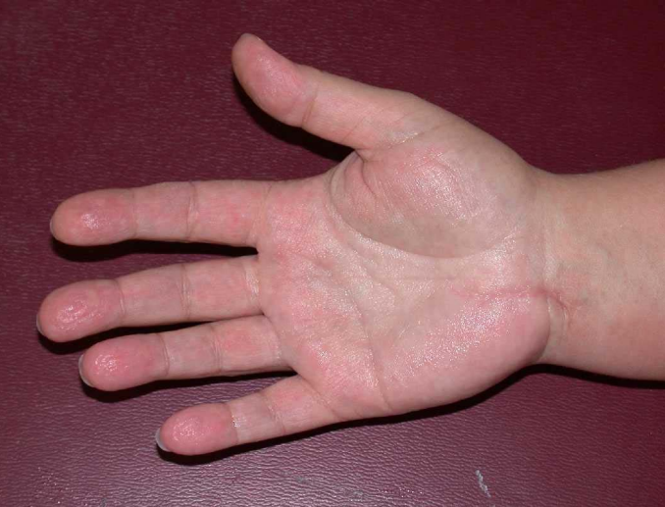
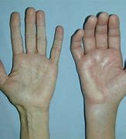
Abnormal Sweating

Slide 10
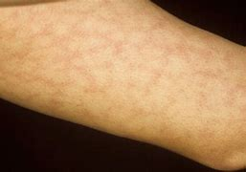
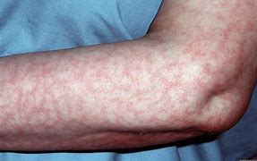
Livido Reticularis

Slide 11
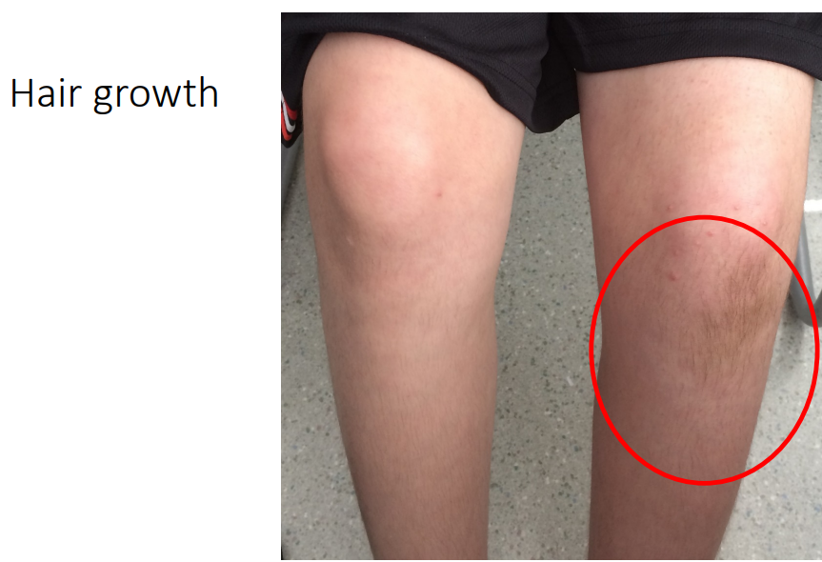

Slide 12
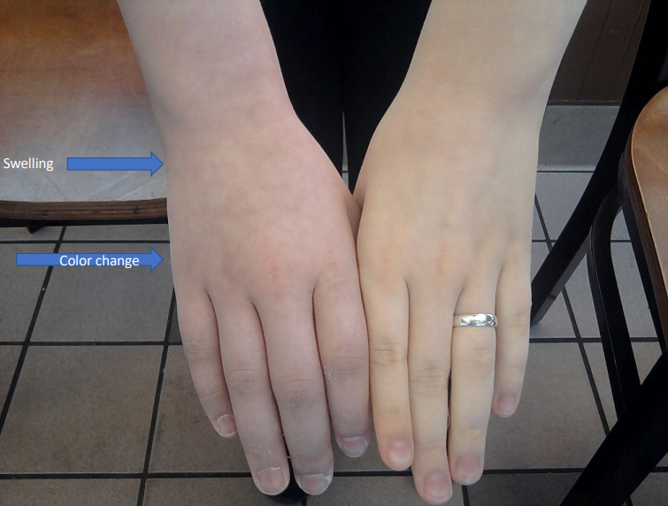

Slide 14
Hand on Fire

Slide 15
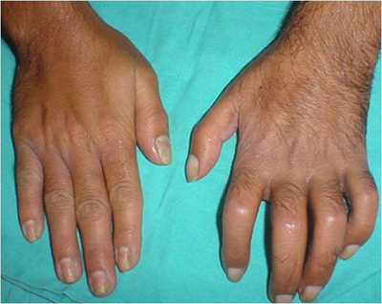
Loss of Motion & Contractures

Slide 16
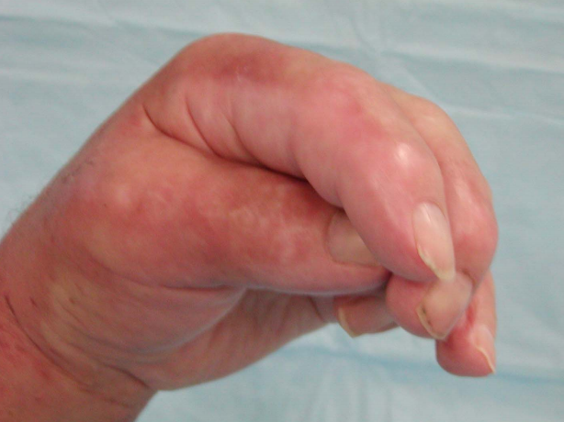
Dystonia (Movement disorder; involuntary movements; tremor)

Slide 17
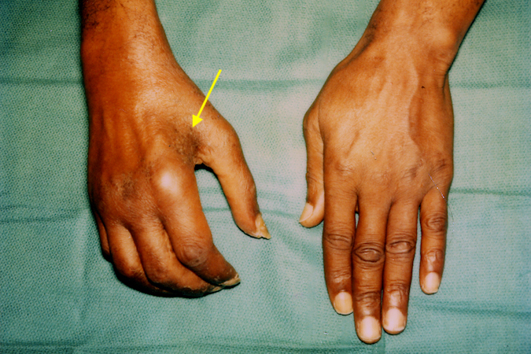
Muscle Spasm progressing to Wasting

Slide 18
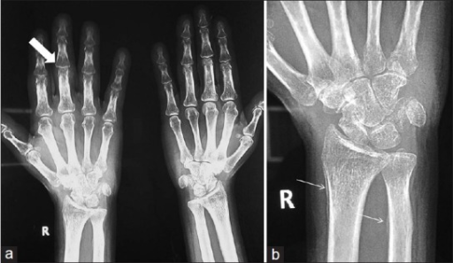
Osteopenia (reduced bone mass)

Slide 19
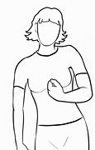
CRPS Presentation
Pain increased by
Dependency (hanging down) of the affected limb
Physical contact (the touch of clothes or bed sheets)
Emotional upset
Visual & auditory stimuli may aggravate pain
Use/Examination by physician
Pain may spread proximally or to other limbs

Slide 20
CRPS Etiology
Why some and not others?
We do not know

Slide 21
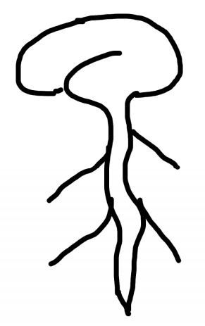
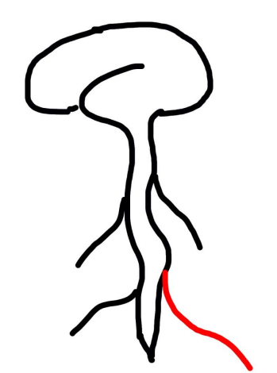
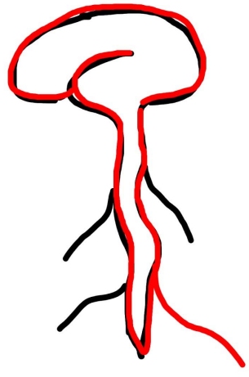
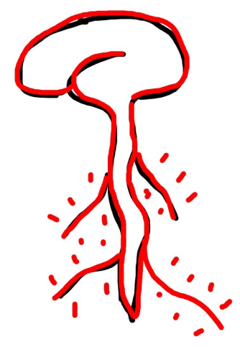
CRPS Key Concept: Central Sensitization
The brain and spinal cord become hyper-sensitized
Simple touch painful when interpreted by the brain

Slide 22
Evaluation & Diagnosis
Best Diagnostic Tool is a thorough medical exam
Careful review of medical records
History: Asking the right questions to diagnose CRPS
Physical examination: Special attention is paid to temperature measurements, sensation, skin coloration, hair & nail changes, atrophy, swelling & surface moisture (sweat), tremor, body positioning, etc.
Symptoms fluctuate day to day and can change even during the physical examination (which can complicate claims management!)

Slide 23
CRPS Diagnosis
Disease awareness & clinical observation
The claims examiner or attorney can be the first to recognize the condition!
“Classical” symptoms not always present
Early stages: subjectives > objectives
No evidence of psychological CRPS “susceptibility”
CRPS evaluation complicated by
CRPS self-diagnosis via Internet
Psychosocial issues
Adverse childhood experiences (ACEs)
Psychiatric comorbidity

Slide 24
Diagnostic Criteria per ACOEM
CRPS Diagnostic Criteria for Clinical Purposes
Continuing pain that is disproportionate to the inciting event.
At least one symptom in three of these four categories:
Sensory: hyperesthesia and/or allodynia
Vasomotor: temperature asymmetry and/or skin color changes and/or skin color asymmetry
Sudomotor/edema: edema and/or sweating changes and/or sweating asymmetry
Motor/trophic: decreased range of motion and/or motor dysfunction (weakness, tremor, dystonia) and/or trophic changes (hair, nail, skin)
At least one sign at evaluation in two or more of the following categories:
Sensory: evidence of hyperesthesia to pinprick and/or allodynia to light touch, and/or temperature sensation, and/or deep somatic pressure and/or joint movement
Vasomotor: evidence of temperature asymmetry (>1°C) and/or skin color changes and/or asymmetry
Sudomotor/edema: evidence of edema and/or sweating changes and/or sweating asymmetry
Motor/trophic: evidence of decreased range of motion and/or motor dysfunction (weakness, tremor, dystonia) and/or trophic changes (hair, nail, skin)
Diagnosis: CRPS is excluded by the existence of conditions that would otherwise account for the degree of pain and dysfunction.

Slide 25
CRPS Diagnosis Tests
X-ray: patchy demineralization (osteopenia) in chronic stage
3-phase bone scan: increased blood flow, pooling, and periarticular uptake (subacute stage up to 1 year)
Temperature measurements
Sympathetic nerve block
BUT a negative result does not rule out CRPS

Slide 26
CRPS Differential Diagnosis
Can it be something else?
Swollen leg(s) due to venous clot or congestive heart failure
Cold limb 2º to arterial blockage (peripheral vascular disease; Raynaud’s)
Infection of skin (cellulitis) and bone (osteomyelitis)
Nerve root, or peripheral nerve entrapment/neuropathy
Disc herniation with nerve root impingement (radiculopathy)
Thoracic outlet syndrome
Ulnar nerve entrapment at the elbow
Carpal tunnel syndrome
Peripheral neuropathy

Slide 27
CRPS Treatment
Diagnosis should be followed by a multi-faceted program involving a functional restoration approach:
Medical
Medications (optimization)
invasive procedures/interventions
Rehabilitation
physical rehabilitation
psychological care

Slide 28
Medications
Opioids
Non-opioid analgesics
acetaminophen & NSAIDs
Steroids
Antidepressants
Sedatives & tranquilizers
Anticonvulsants
Muscle relaxants
Ketamine (NMDA inhibitor)
Topical agents
Lidocaine or capsaicin
Compounded creams
Biophosphonates
Calcitonin
Retard bone resorption
Alpha adrenergic antagonists
Clonidine (Catapres®)

Slide 29
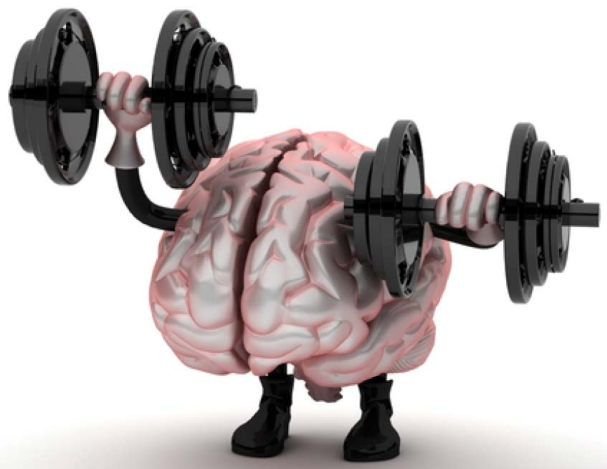
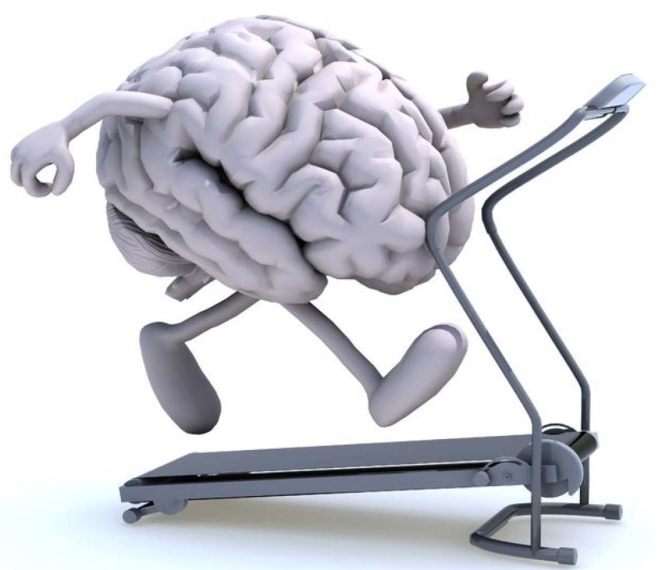
Rehabilitation
Patient educated & active participant
Patients encouraged to use the affected limb

Slide 30
Physical Rehabilitation Treatment Examples
Stretching & Strengthening
Therapeutic exercise
Improved body mechanics
Aerobic conditioning
Tai Chi
Teach flareup management
Home exercise program (HEP)
Mobilization
Edema control
Tactile desensitization
Stress loading
Exposure therapy
Mirror therapy
Deal with pain avoidance/reinjury fear

Slide 31
Psychological Treatment Examples
Techniques for pain control and reduction
Cognitive behavior therapy (CBT)
Biofeedback
Stress reduction
Mindfulness meditation
Relaxation training
Virtual Reality Devices

Slide 32
Psychological Services
Focus of treatment
Change perception and emotional response to pain
Provide coping strategies
Reduce distress and catastrophizing
Improve functioning and social engagement
Exposure to fearful activities
Activities to divert attention to pain

Slide 33
MTUS Supported Treatment
Psychological approaches (CBT & Biofeedback)
PT (back school, exercise and work conditioning)
Acupuncture
Aquatic therapy
Yoga
Medications
Local Anesthetic Injections to Dx Chronic Pain
Nerve blocks for neuropathic pain
Early Intervention
FCEs
Functional Restoration Programs

Slide 34
Controversial Treatments
Implanted pain pump
Surgery in the patient with CRPS
Surgical nerve decompression
Amputation

Slide 35
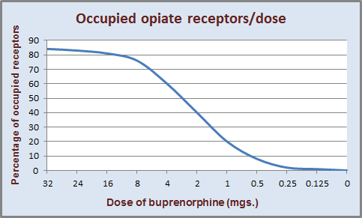
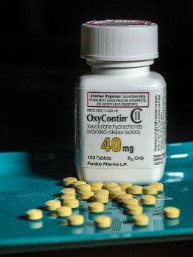
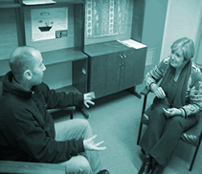
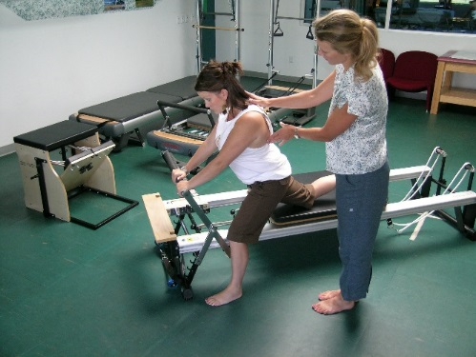
Functional Restoration Program
MED Dose/day
Medication/opioid
Optimization
Cognitive Behavioral
Therapy (CBT)
Co-located services
Team: MD, PT, Psychologist
Communication
Treatment: Education, meds optimization, increased function & ever day life activities
Physical Restorative
Therapies
Education and
Psychosocial Focus

Slide 36
CRPS & Future Medical Care
CRPS can significantly increase future
Medical & psychiatric comorbidities
Costs of treatment
Cost of adaptive equipment/modifications
Loss of earning capacity
Need for ADL & task assistance (aide)
Loss of household services abilities
Housekeeping
Outdoor maintenance
Notes:
Life Care Planning for People with Chronic Pain (rpcconsulting.com)

Slide 37
Steps to Achieve Negative Outcomes
Employers who treat all injuries as fraudulent, and injured workers as frauds.
Employers who do not immediately report all injuries; thereby delaying prompt compensability determination and benefits.
Employers who create barriers that delay return-to-work.
Employers (front line supervisors or managers) who do not remain in contact with injured employees (particularly during time off from work).
Delays in compensability determination by the claim administrator.
Medical treatment authorization delays which result in a lack of access to quality, evidence based medical care due to a complex and unnecessary authorization process.
Attorneys who do not focus on assisting the injured worker in returning to health and work.

Slide 38
Steps to Achieve Positive Outcomes
Education: What is CRPS? How do you diagnose and treat it?
When CRPS suspected, support referral to appropriate specialists.
Develop plan of action for managing claim.
Promptly authorize MTUS EBM testing and treatment
Recognize when there are delayed recovery factors (including ACEs).
Emphasize appropriate communication with all parties including the injured worker.
Set appropriate expectations for recovery and RTW to modified or full duty.
Support physical activity & rehabilitation approach.
Encourage the injured worker to seek support from family, friends, social, and if appropriate, religious, community.

Slide 39
CRPS SUMMARY
CRPS is a syndrome
CRPS is uncommon
Often missed, over- or under-diagnosed
CRPS diagnosis contentious
Occurs typically soon after injury/event
Pain disproportionate to inciting event
Can spread proximally & to other body parts
Can result in significant physical and psychiatric disability
CRPS can significantly increase future costs
Notes:
Life Care Planning for People with Chronic Pain (rpcconsulting.com)

